Slide 1
Online testing tips
Clare Sutherland

Slide 2
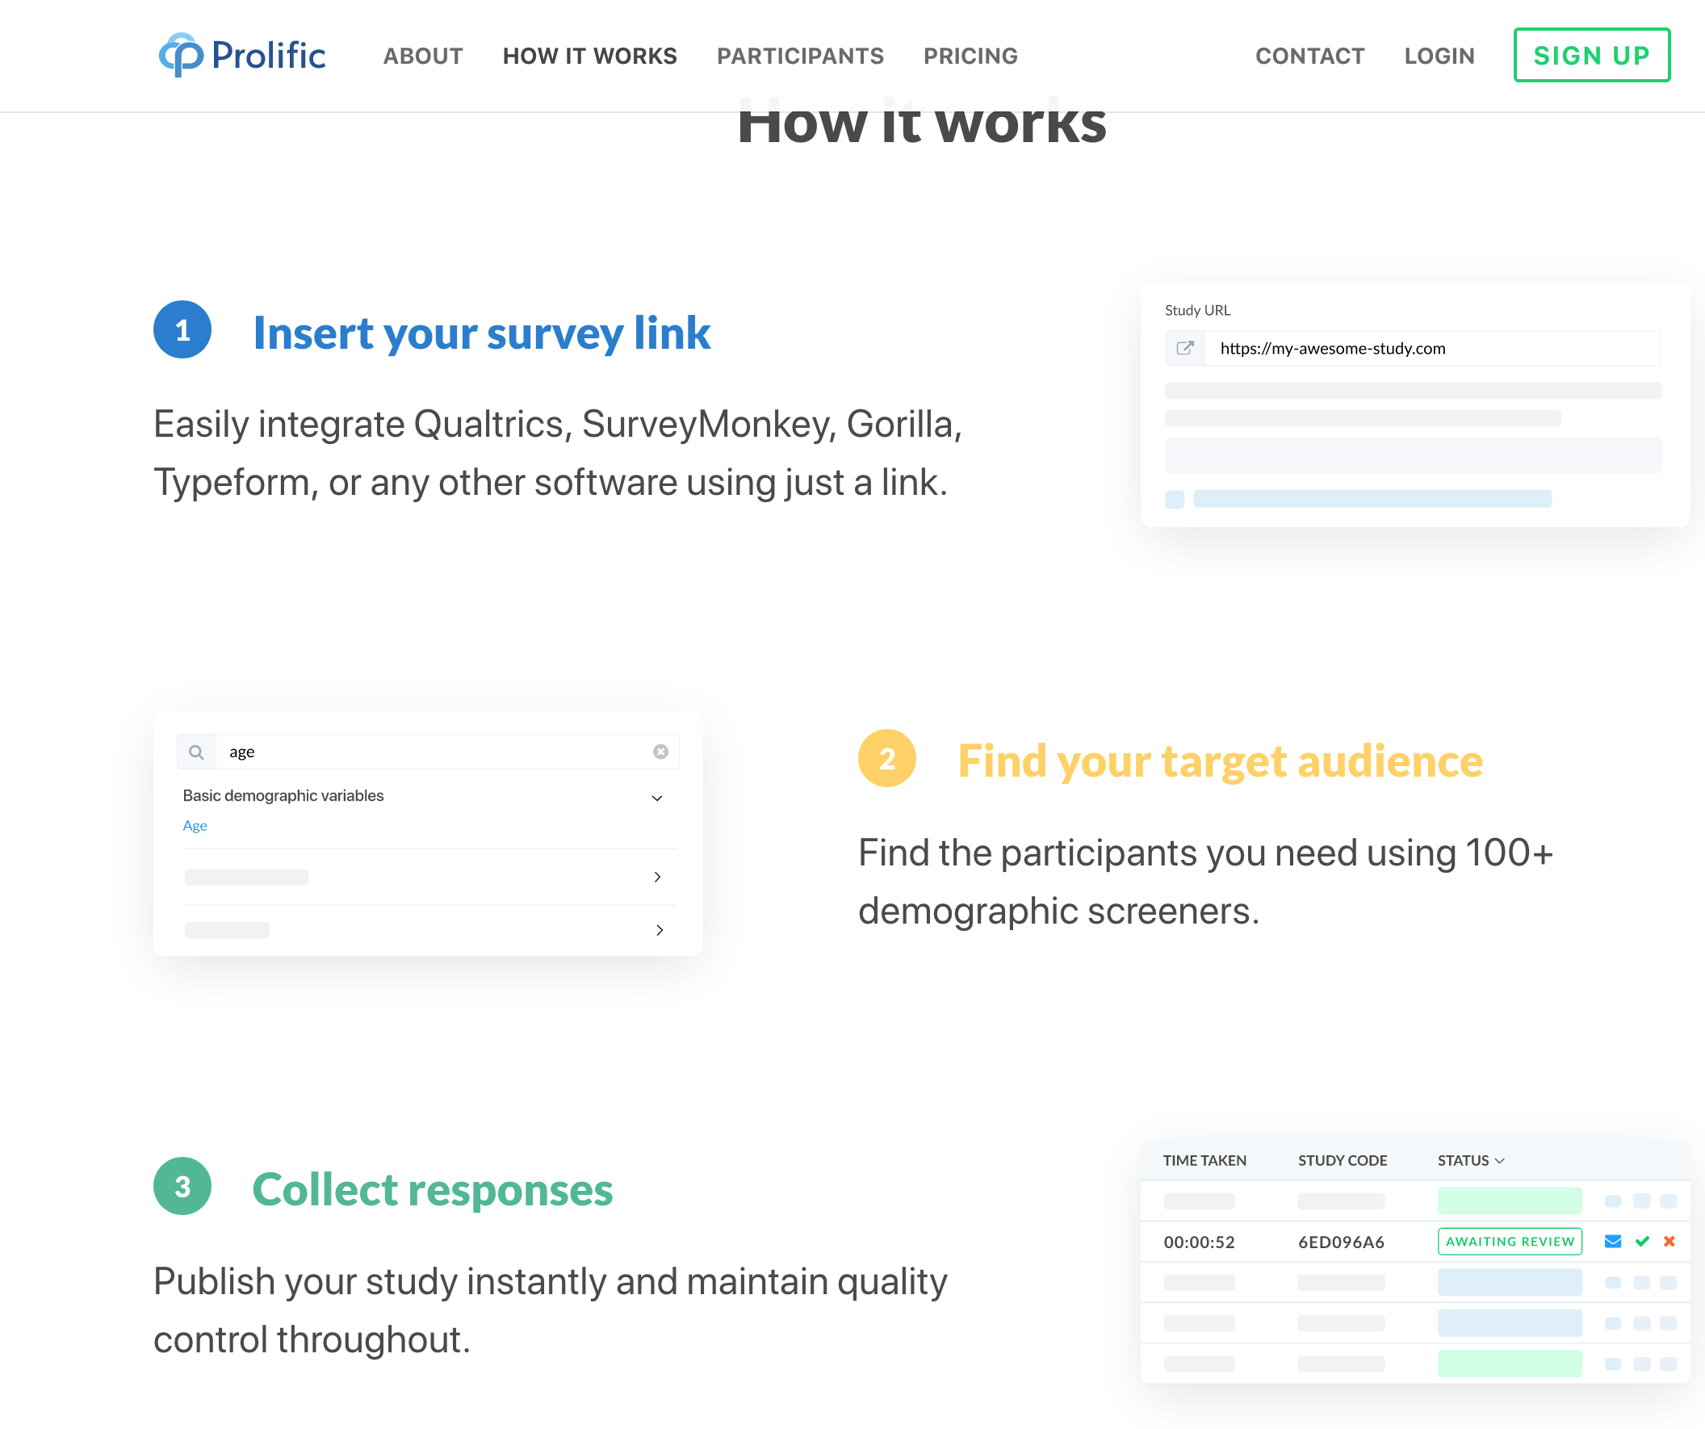
Online recruitment platforms
Prolific Academic
Amazon’s Mechanical Turk (Mturk)/TurkPrime
SONA

Slide 3
General advice
Check the timezone of the country e.g. UK/US before posting the study
Be at your email when the study is running – people will email you for help
MTurkers (participants) openly discuss studies and Requesters (experimenters) online

Slide 4
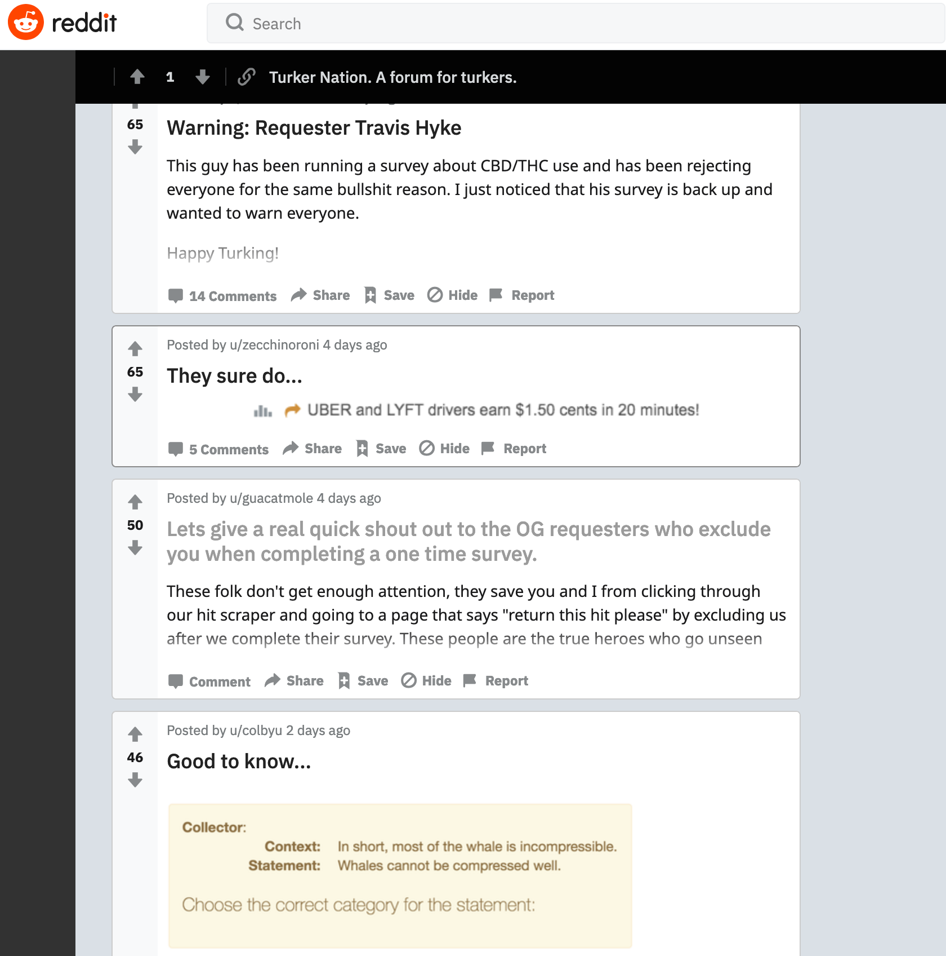

Slide 5
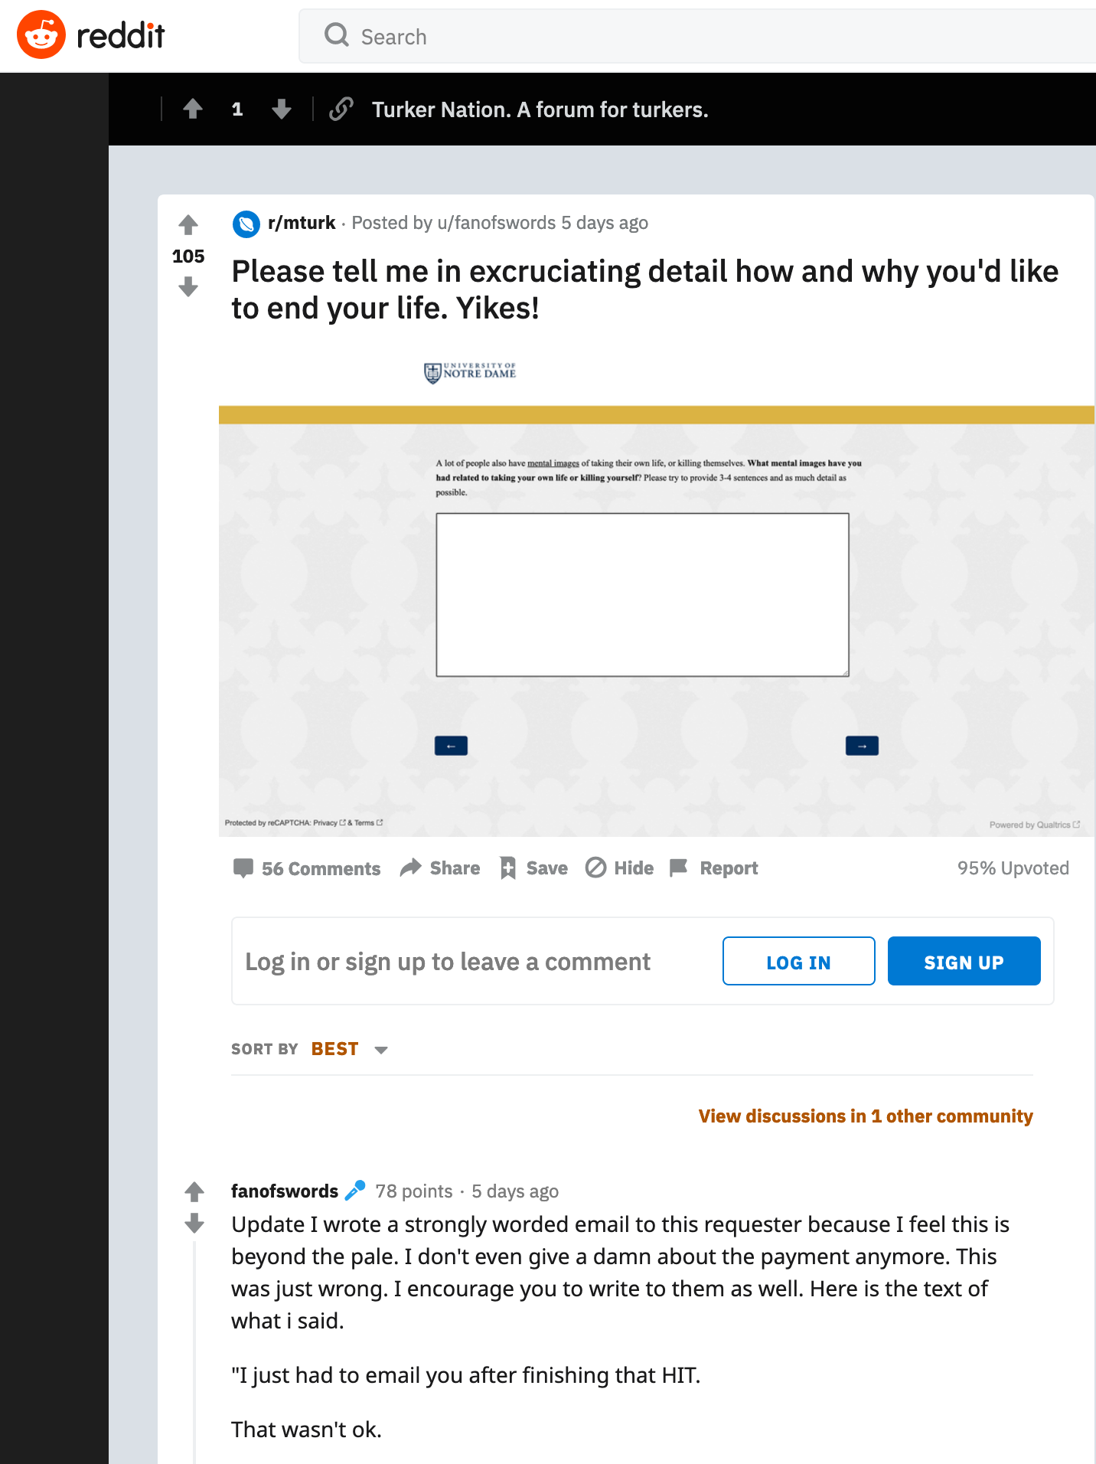

Slide 6
Paying participants
PA and MTurk -> participants paid at least minimum wage (GPB or US)
Reviewers will query payment if too small
I usually pay a bonus for longer/repeat experiments
For ethical reasons, usually pay everyone, even people who didn’t complete the study (and just blacklist from future studies). On MTurk if you don’t pay people, it really harms their score + likelihood of future work.
Also, trying to manually search through e.g. 1,000 responses = T.E.D.I.O.U.S

Slide 7
Paying participants
Some testing software will let you set up secret codes or links to the completion page on MTurk/PA at the end of your study; then participants can be automatically paid as soon as they complete or fill out the secret code
Some testing software will let you do the same on SONA so participants automatically get credited when they finish (E.g. Qualtrics, Testable, Inquisit – Gorilla?)
Payment/contacting participants on MTurk is accessed only within one account, so it makes more sense to have a lab account e.g. if PhD students are running experiments

Slide 8
Criteria for participants
When running experiment on MTurk it is important to set good criteria.
Pick people who understand English! (e.g. set to UK or US)
Pick people who have experience in doing Turk exps (not beginners) (see number of hits)
Notes:
Maybe it would be good to explain what Hits is, what workers are, etc etc
Also, this website has a lot of interesting videos which are basic tutorials to mTurk: https://bradylab.ucsd.edu/ttt/ Day 1 is an awesome intro to Turk

Slide 9
Screening participants (ethnicity, age etc)
Notes:
https://www.cloudresearch.com/resources/blog/are-mturk-workers-who-they-say-they-are/

Slide 10
Screening participants (ethnicity, age etc)
Notes:
https://www.cloudresearch.com/resources/blog/are-mturk-workers-who-they-say-they-are/

Slide 11
Screening participants (ethnicity, age etc)
Prolific Academic has very good pre-screening criteria
Mturk has less good pre-screening criteria – CloudResearch/Turkprime improves it but not by much.
Some platforms (e.g. TurkPrime, also Testable) add demographic questions to the end of your study unless you turn it off – we usually turn off

Slide 12
Screening participants (ethnicity, age etc)
Post a qualifier study up on MTurk, allow 1,000 people to take part (two mins)
Choose participants based on response
Email 300 participants on TurkPrime API with link to real study (10 mins)
Cost = e.g. 20 cents, total $200
Cost = e.g. $2, total $600
Notes:
e.g. test 1,000 people on some easy categorisation captcha style task, plus ask demographic questions)
gets attention and they’re more motivated

Slide 13
Experimental Instructions
Obviously, you won’t be at the computer to answer questions (except by email)
So experiments need to be more “standalone” than a lab based experiment
Also wise to use “plain language” as mostly not scientists/psychology students

Slide 14
Internal quality control checks
We don’t ask explicit catch questions anymore (used to be recommended). Can lower data quality as you lose the trust of participants
2. Run a captcha (stop bots)
3) Get people to answer a free text question (remove anyone who writes gibberish/poor English)
4) Ask explicitly if we should use their data. Remove anyone who asks us to remove data even if reason not given.
1. Pre-screen people using a qualifier - first come, first served
6) Ask age and gender at the start and end – exclude anyone who changes age/gender halfway through
8) Remove any responses with no. variability e.g. all the same button press in any block
5) Ask people what they did in the experiment (e.g. dropdown menu with task choices)
7) remove implausibly fast responses
Notes:
“We’re a small scientific lab who runs experiments using public funding. It’s important to use to get good data for our studies, so please answer the next question honestly. You will still get paid/credited for your time no matter what you write in this question. Is there any reason why we shouldn’t use your data e.g. got bored, experienced distractations, didn’t understand the instructions etc)?”

Slide 15
Ethics – BPS guide to online testing
Important info at start + debrief
If participants withdraw, data deleted? Clarify.
Data totally anonymous - > no way to remove later
are IP addresses stored?
Check shared data = anonymous
Extra care needed sensitive topics
Notes:
people may not get to the end of the study, so any important info needs to be in the initial info as well as the debrief (as much as possible e.g. contact information, access to helplines etc).
if participants withdraw, is their data deleted? You need to clarify to participants what will happen. Some software (e.g. Testable) won’t send you the data unless participants submit it at the end of the study, to avoid this issue
some web software stores IP addresses unless an effort is made to stop this, and IP addresses are extremely identifiable (e.g. Qualtrics does, but it can be turned off; Testable doesn’t, because it is UK based and adheres to BPS guidelines). If researchers find themselves with IP addresses in their data, they should delete this information as soon as possible i.e. after any data cleaning
if data are totally anonymous, like a lot of our studies will be, there is no way to remove the data later on once participants submit. I think our online data consent form already makes this clear but worth checking.
any data which is shared with other researchers should be double checked to make sure its anonymous i.e. it doesn’t have usernames or email addresses in it
extra care is needed if topic is sensitive or if deception is used, as debriefing isn’t in person (and right now as Louise pointed out, a lot of people are feeling very stressed so we should be mindful of the situation)

Slide 16
Useful links
BPS ethics guidelines:
https://www.bps.org.uk/sites/www.bps.org.uk/files/Policy/Policy%20-%20Files/Ethics%20Guidelines%20for%20Internet-mediated%20Research%20%282017%29.pdf
Is web testing as good as the lab?
http://www.chabris.com/Germine2012-WebLab.pdf
Step by step guide to online testing:
https://online-ws.readthedocs.io/en/latest/#contributors
A primer on running human behavioural experiments:
https://psyarxiv.com/wvm3x

